Slide 1
Wiktoria’s Secrets
UQ-Bio Summer School
June 18, 2024
Colorado State University
Wiktoria, Samantha, Pilar, Kaan, Jakini, and Eric

Slide 3
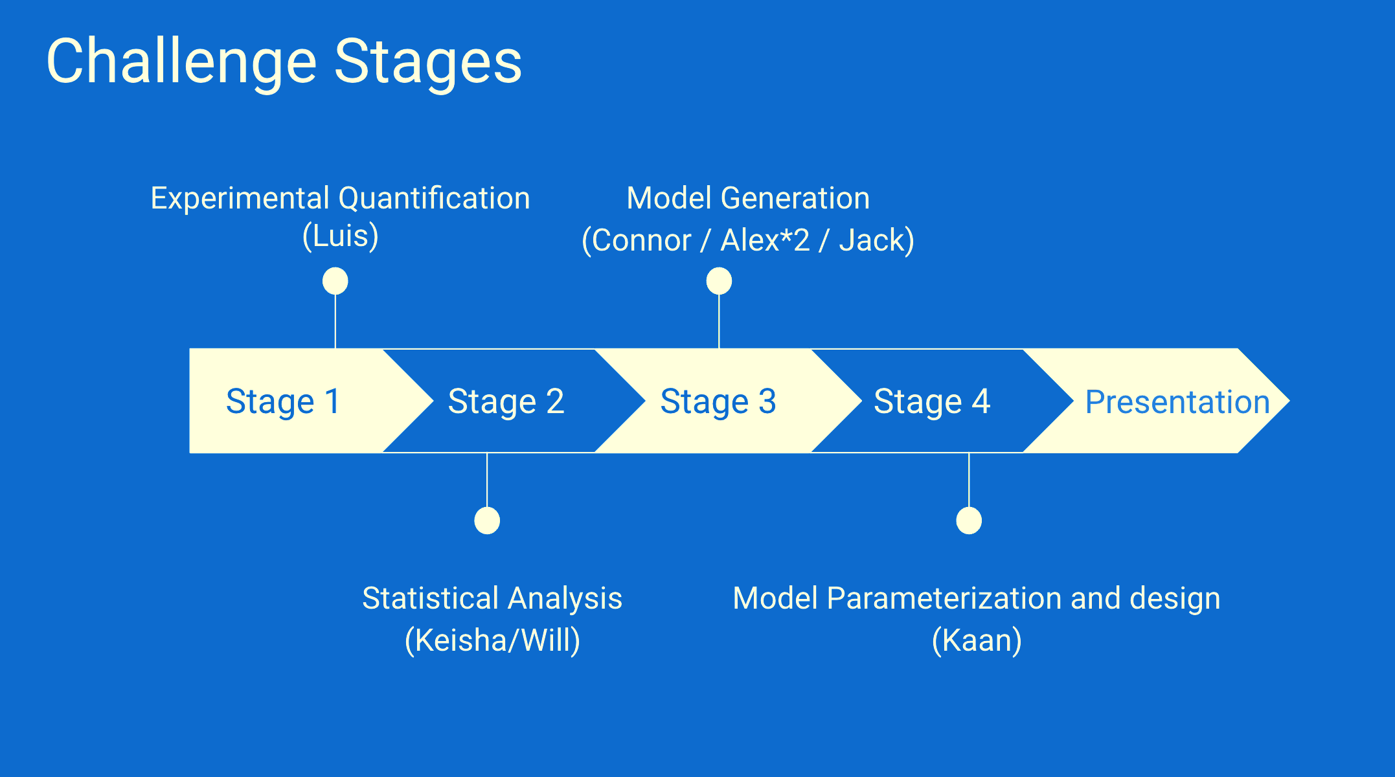

Slide 4
Stage 1: Experimental Quantification

Slide 5
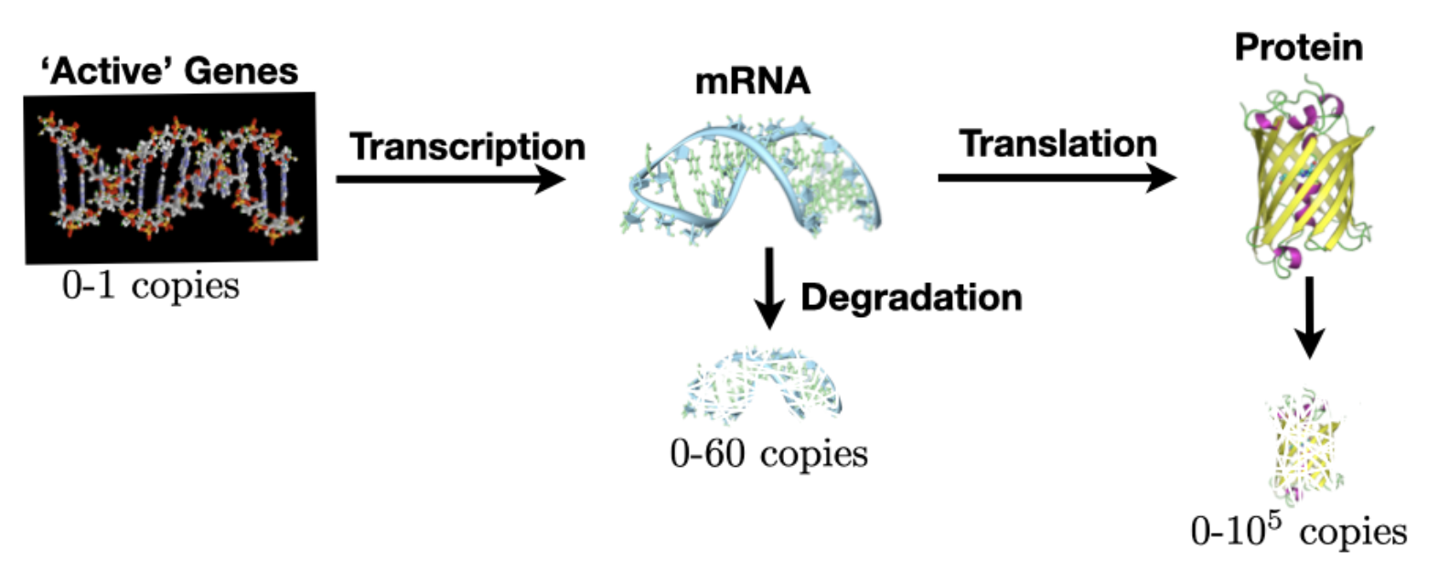
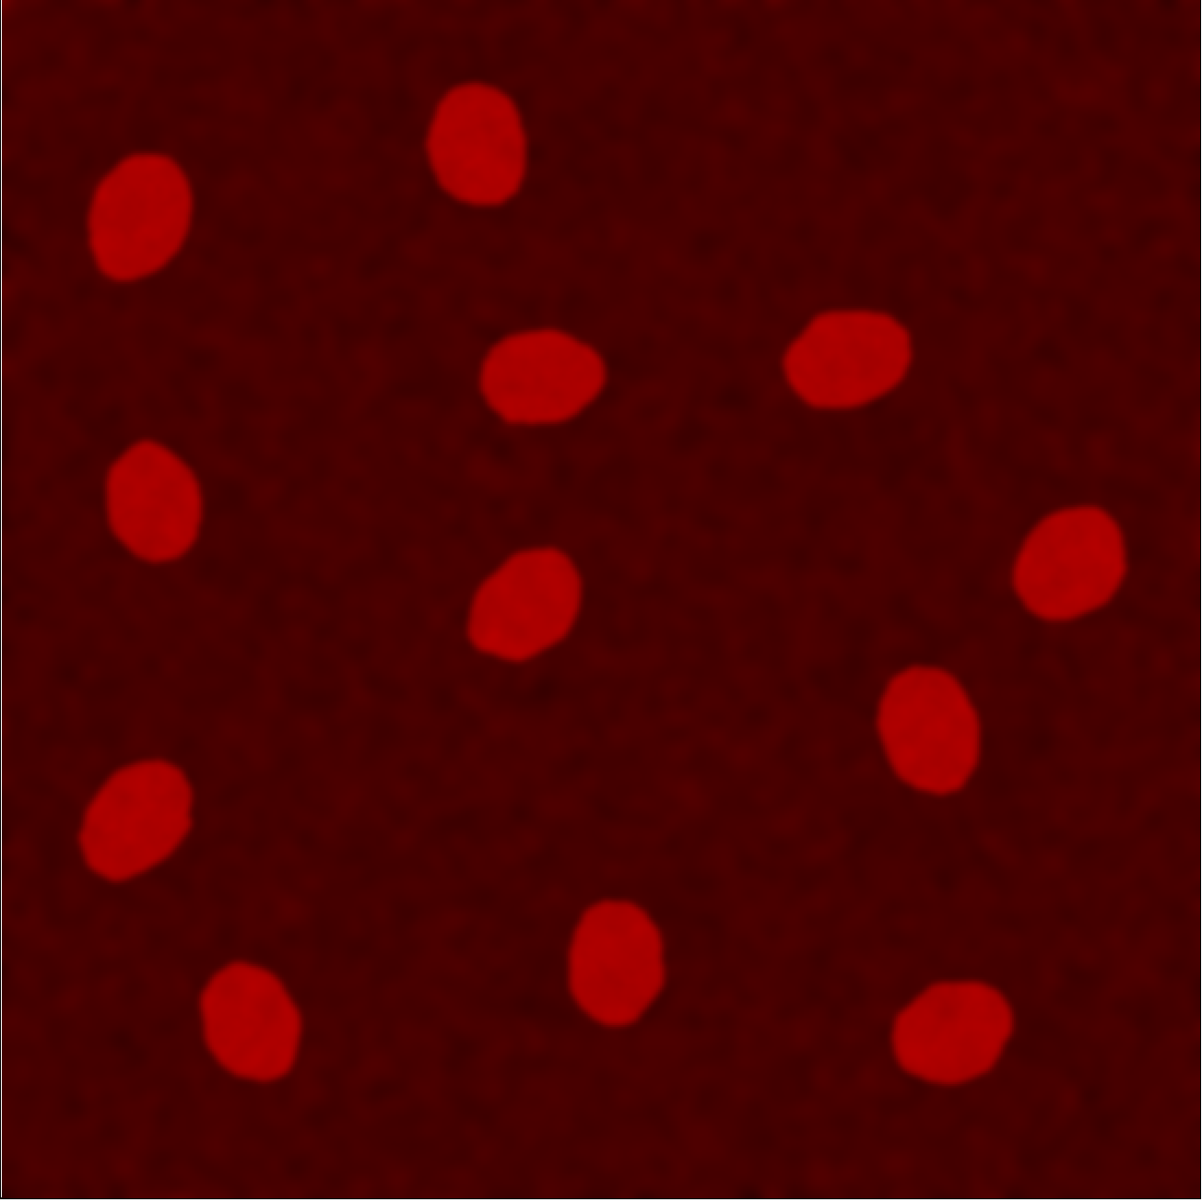
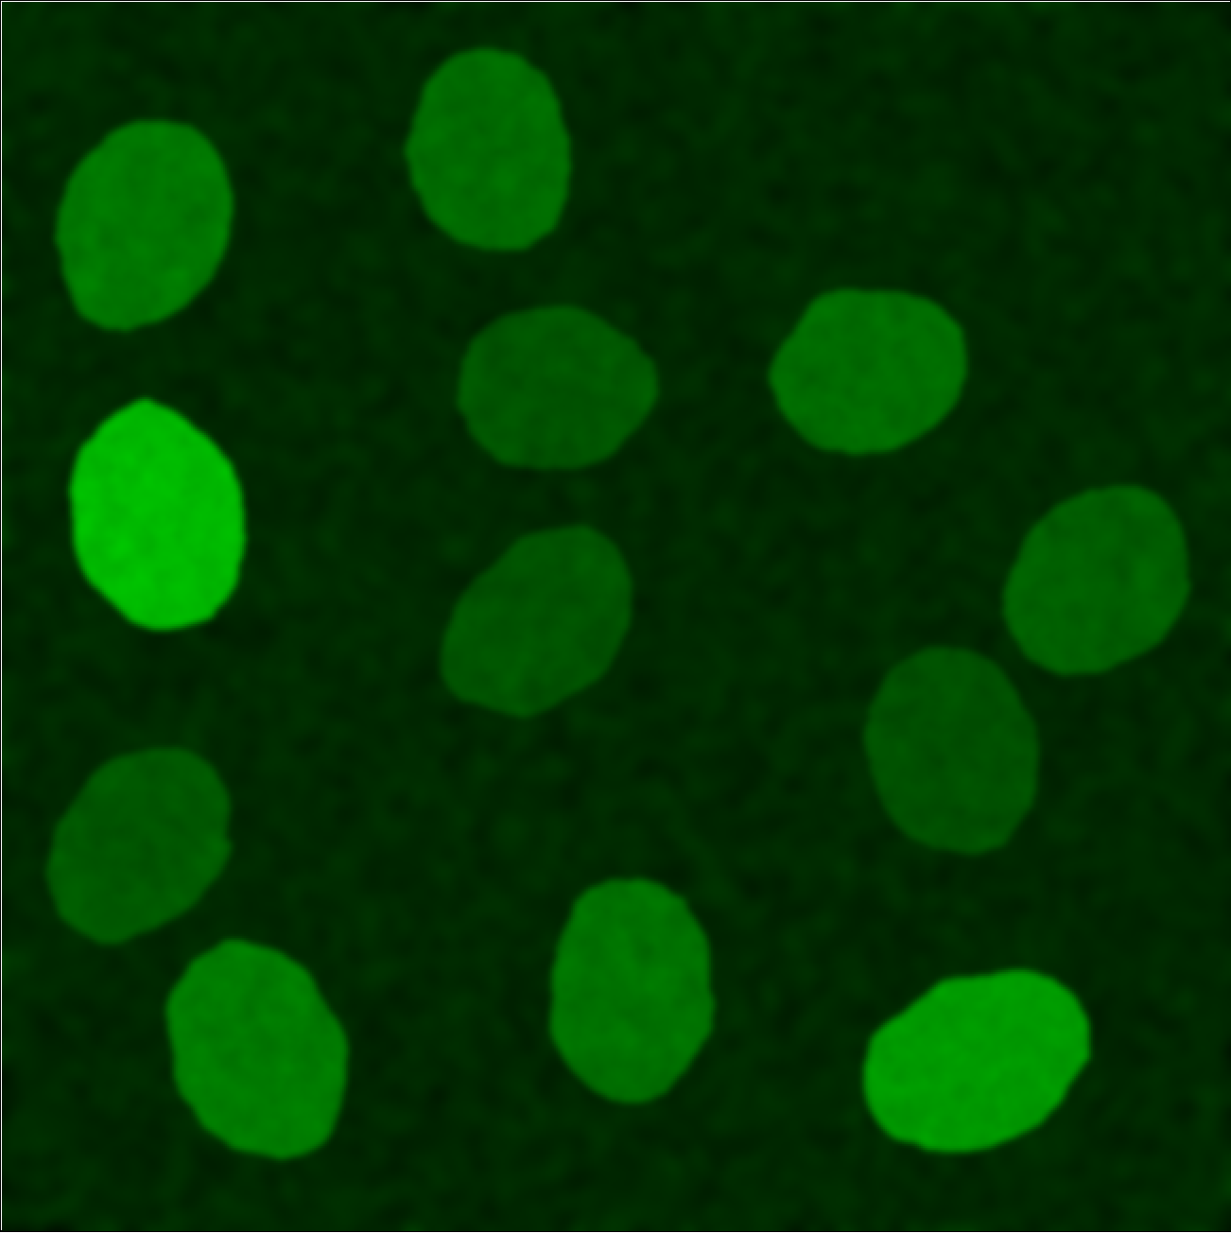
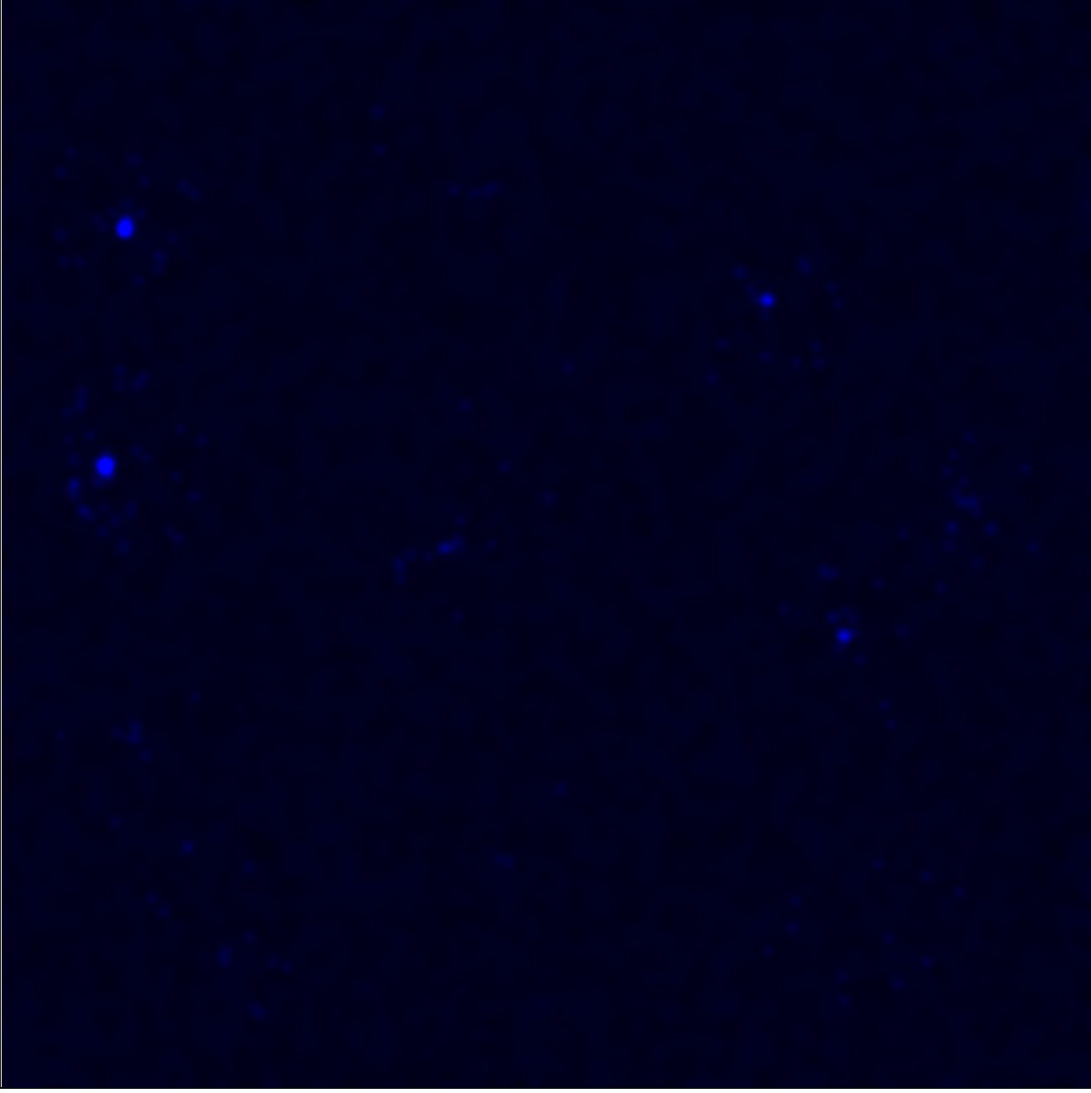
Central Dogma
Red Channel
Nucleus
Green Channel
Protein (cyto)
Blue Channel
mRNA

Slide 6
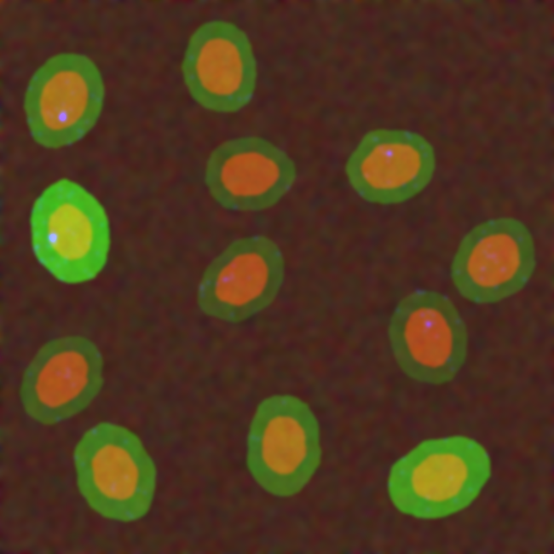
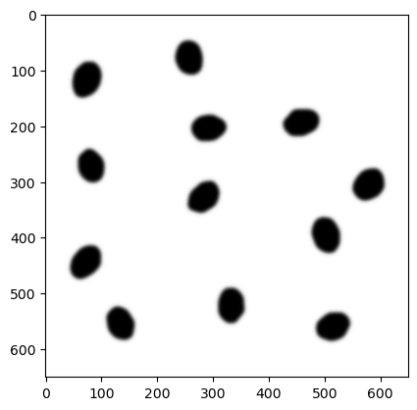
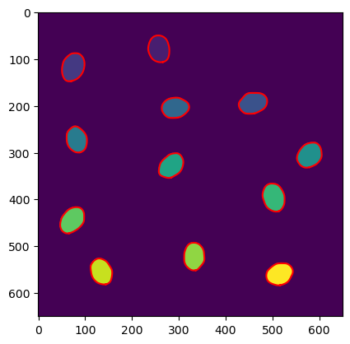
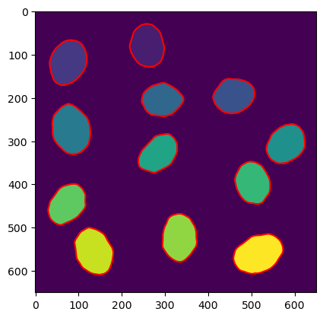
RGB image
Binarized image
Steps to get the csv file with the data for each drug:
Apply Gaussian filter to the image
Select a threshold value and binarize the image
Apply Watershed to differentiate the cells
Apply region prop function to calculate the parameters: numbers of cells and nucleus.
Obtain cell and nuclei size, intensity using masks.
Nucleus mask
Cytoplasm mask

Slide 7
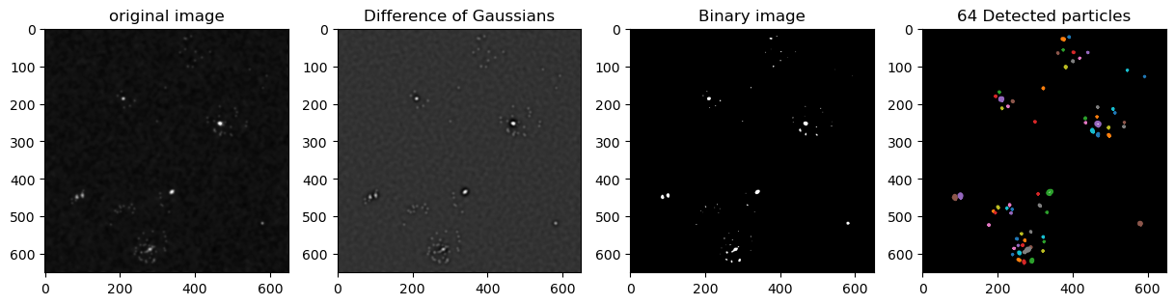
Blue Channel
Difference of Gaussians
Steps to get the csv file with the data for each drug:
Load the masks and labels unique cells
Load the original images
Separate the blue channel
Apply Gaussian filter to the image and binarize it
Label and counts RNA spots within the nucleus and cytoplasm for each cell across all frames, storing the counts in a csv file.
Binary image
Detected particles

Slide 8
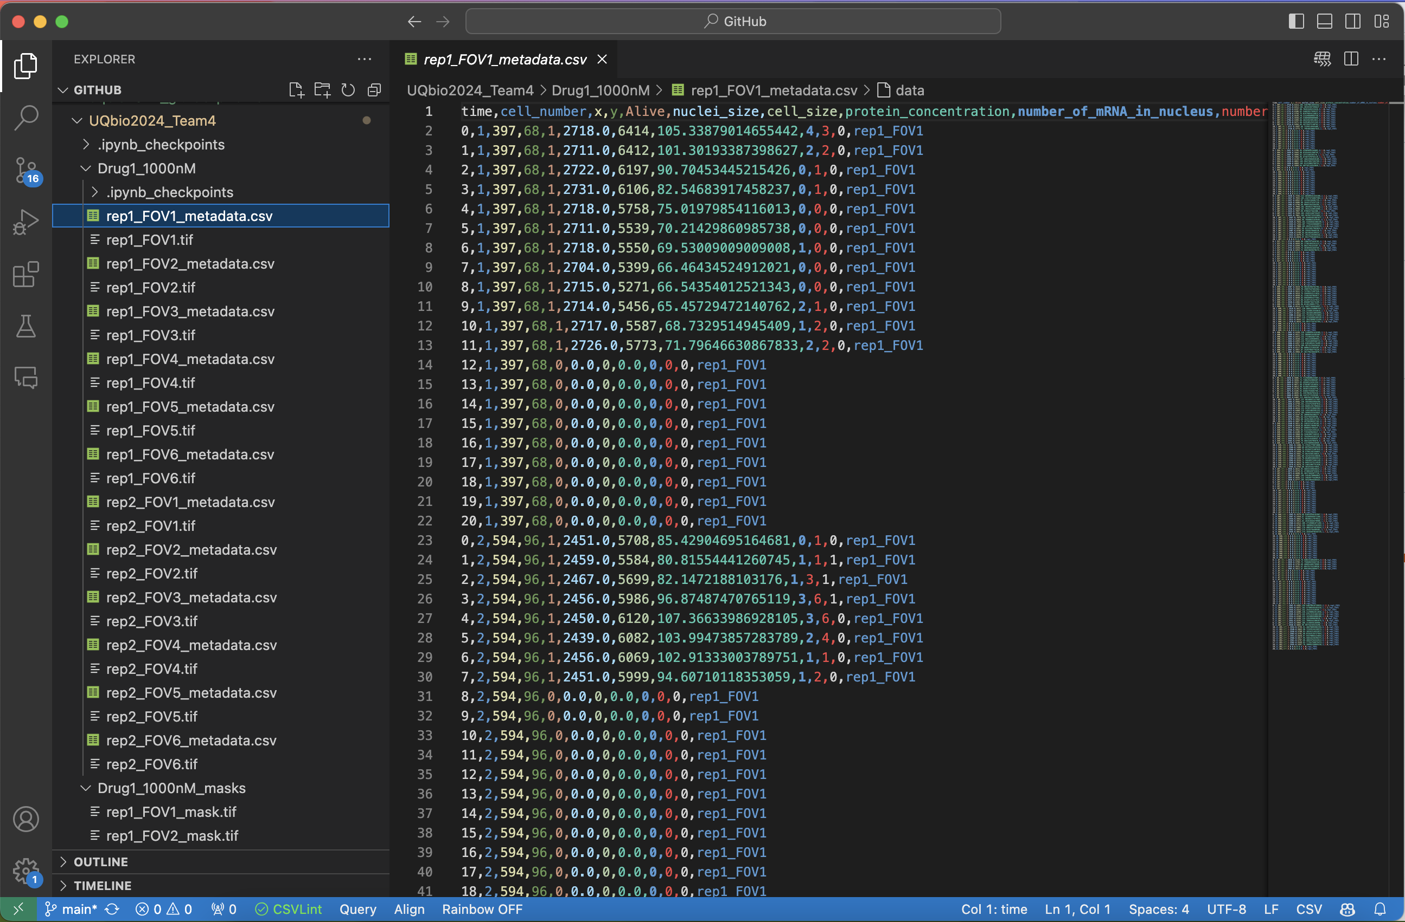

Slide 9
Stage 2: Analysis of the Data

Slide 10
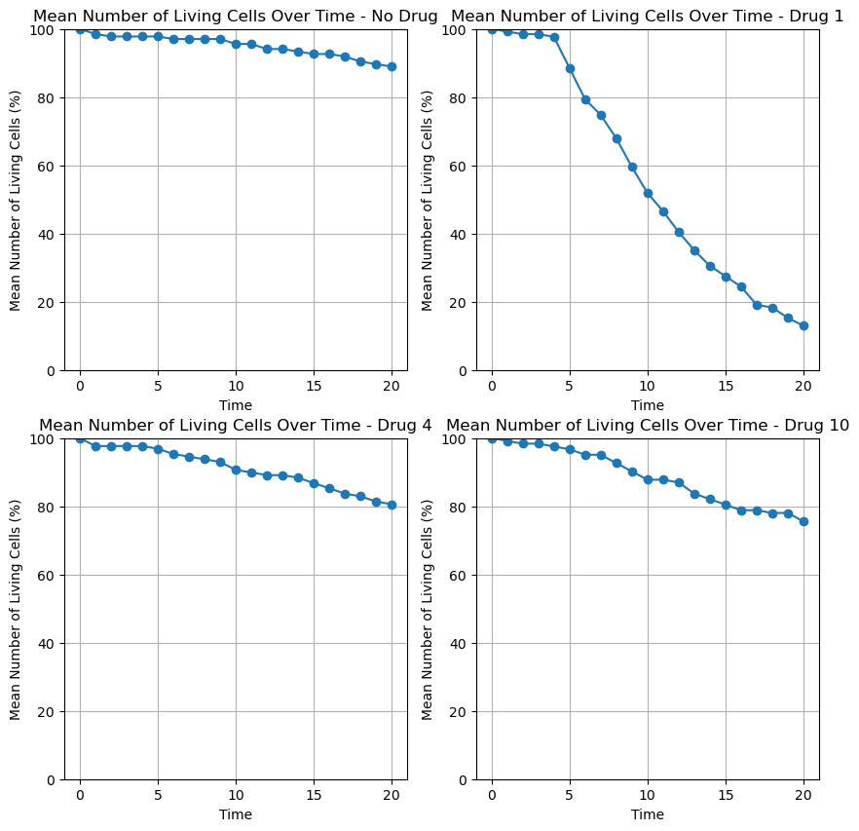
Vitality
No Drug
Drug 1
Drug 4
Drug 10

Slide 11
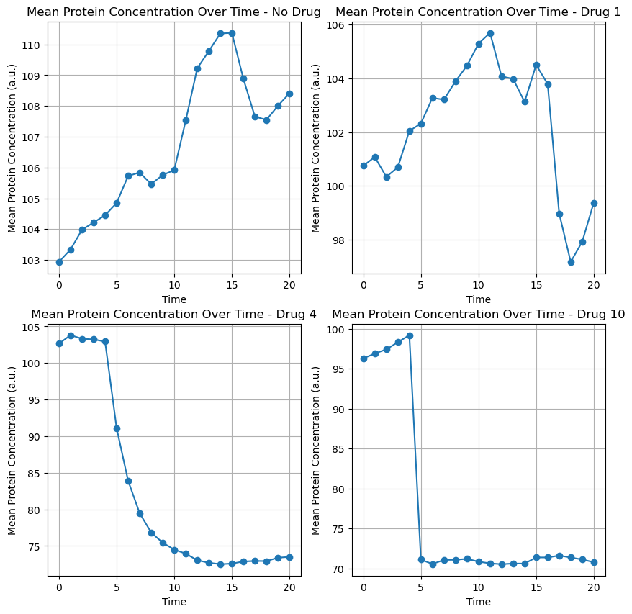
No Drug
Drug 1
Protein
Concentration
Drug 4
Drug 10

Slide 12
Potential Drugs
Discarded Drugs
Drug
1
Drug
3
Drug
5
Drug
9
Drug
8
Drug
2
Drug
4
Drug
6
Drug
7
Drug
10

Slide 13
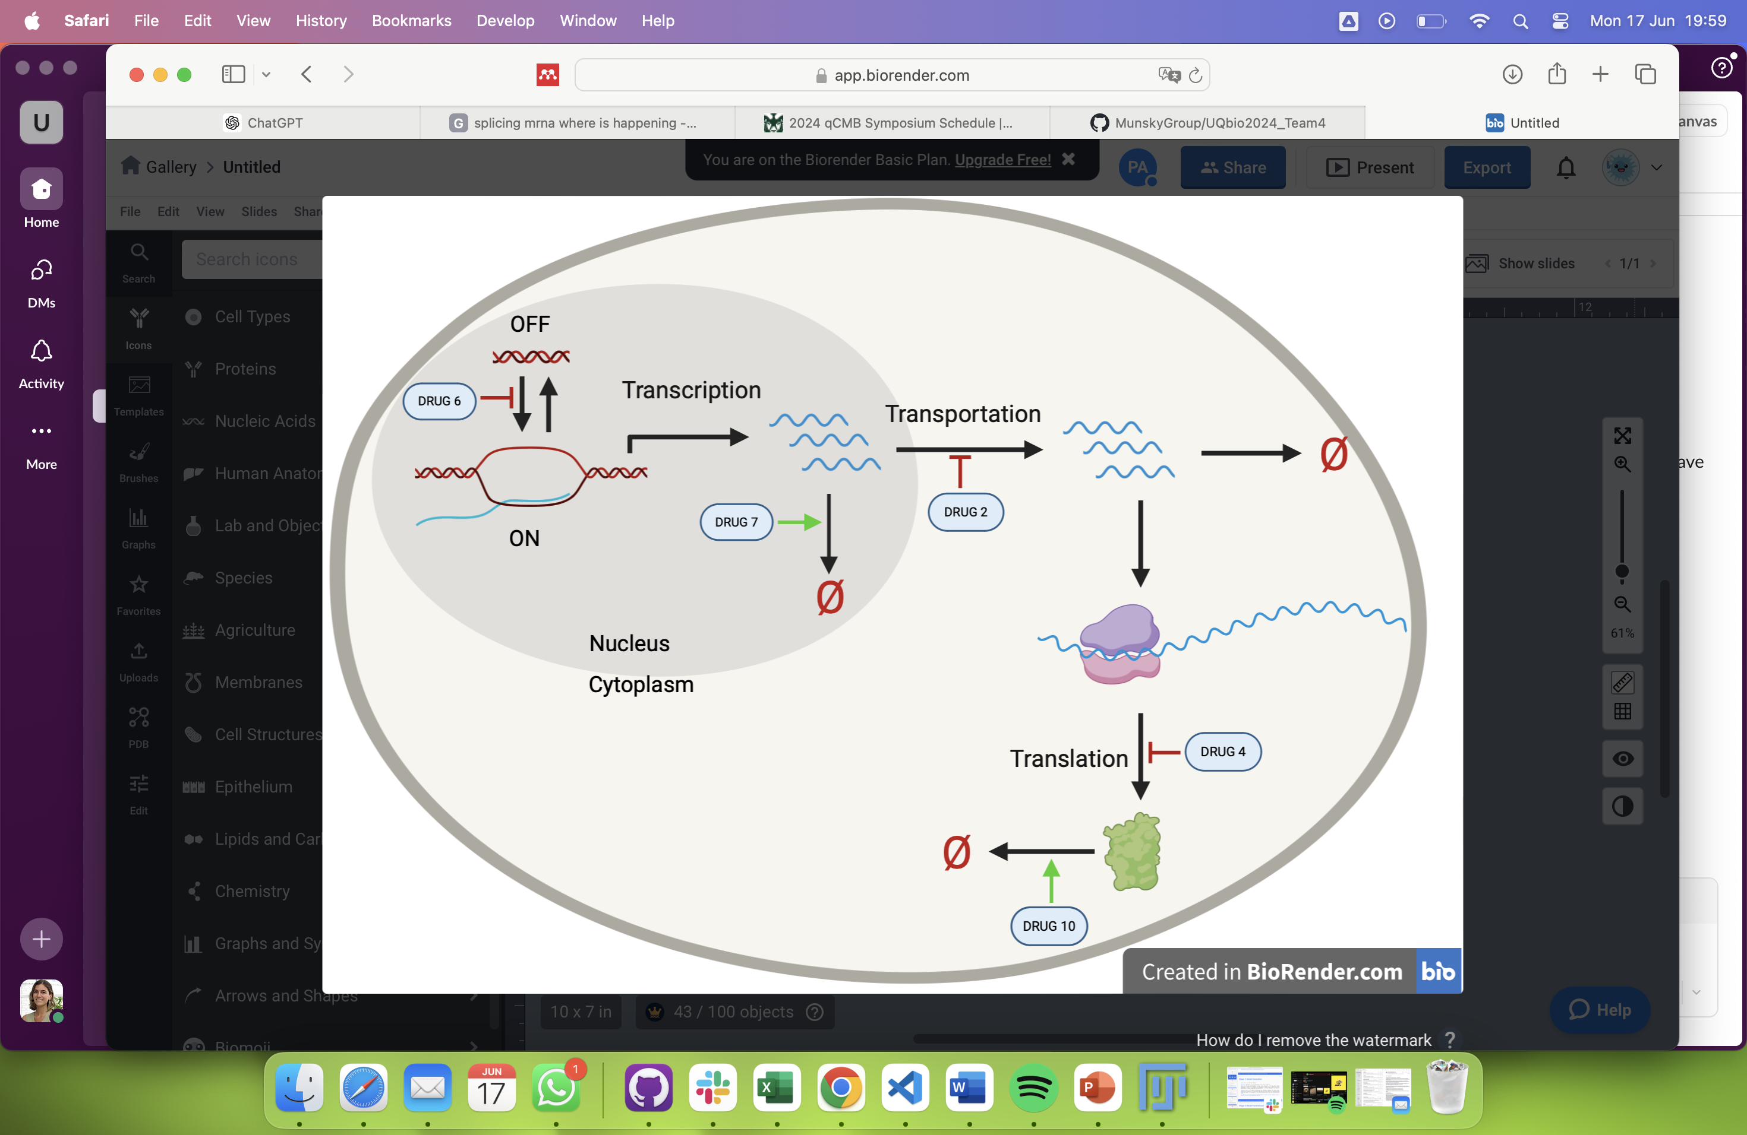
Proposed Model

Slide 14

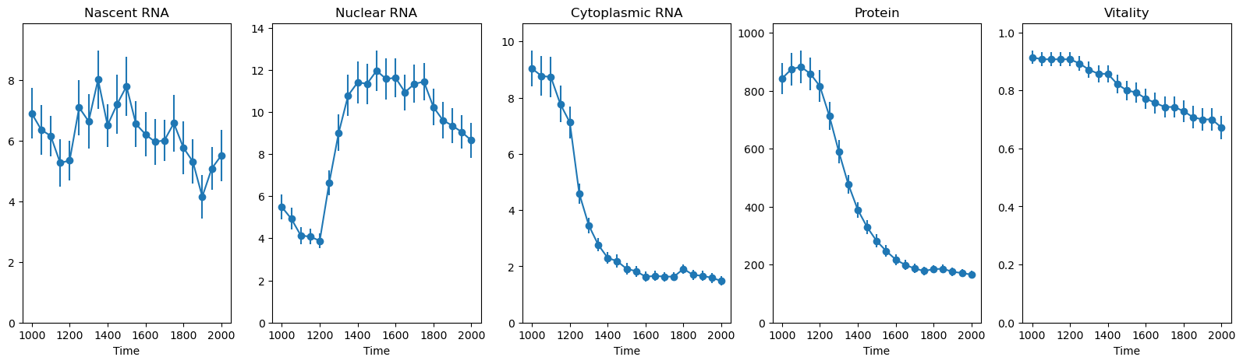
Drug 2
Maturation of mRNA or Transportation process

Slide 15
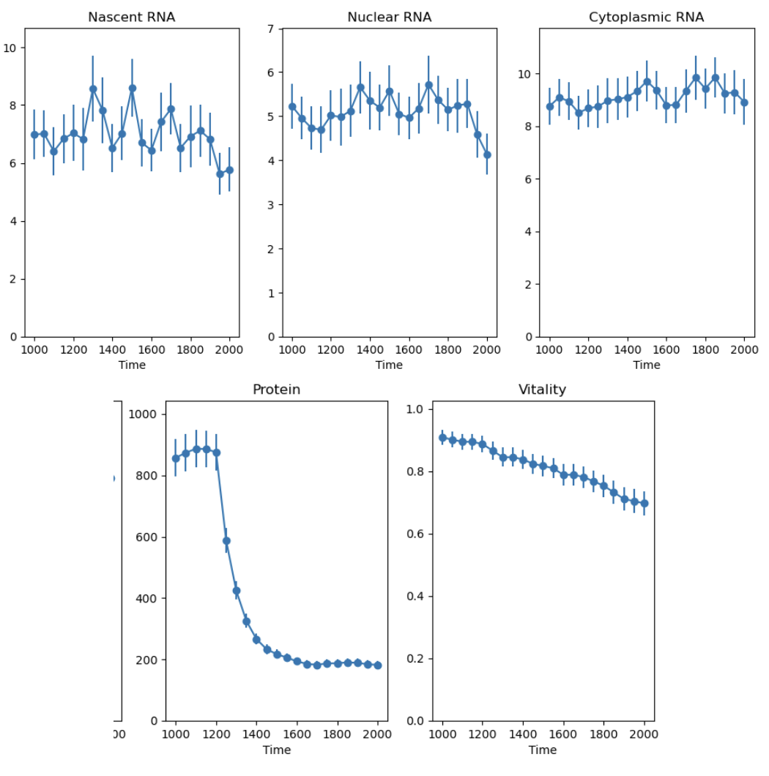
Drug 4

Slide 16
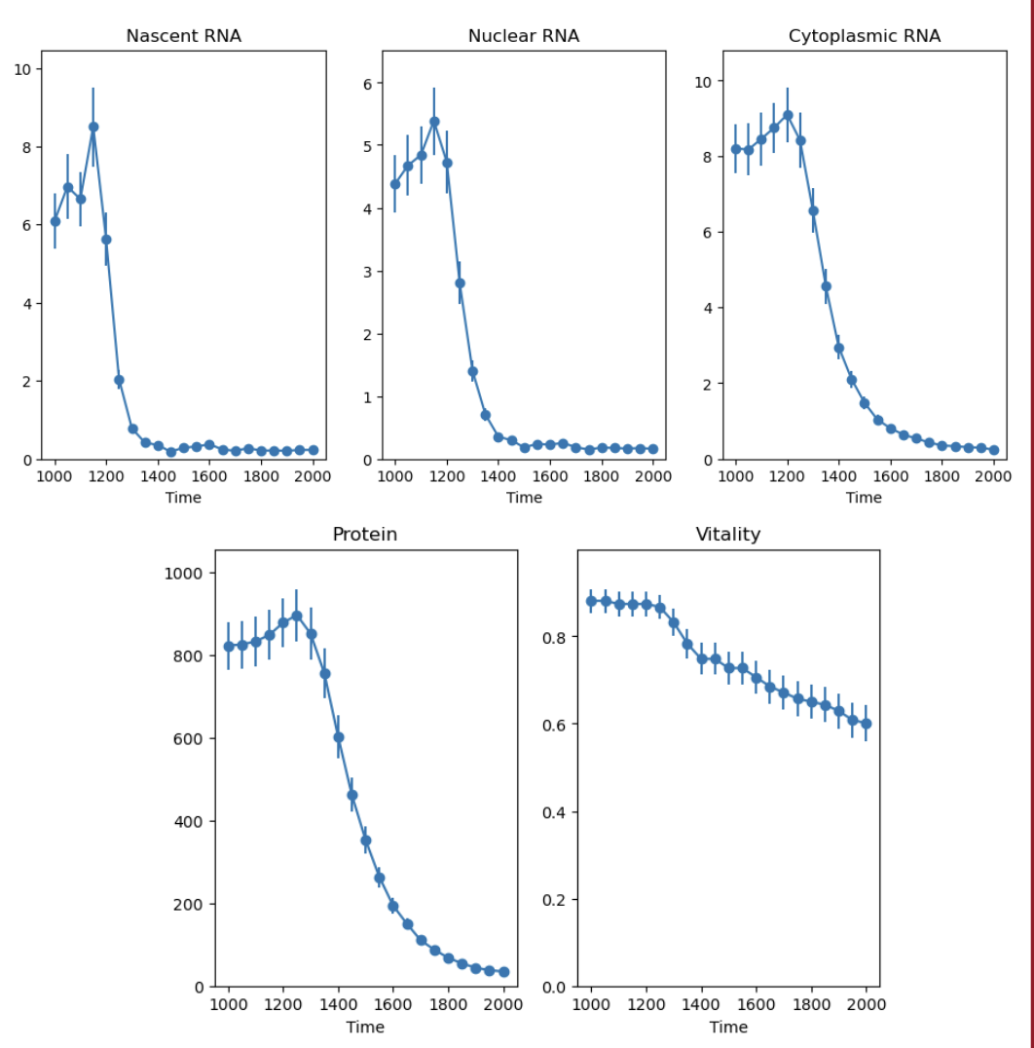
Drug 6

Slide 17
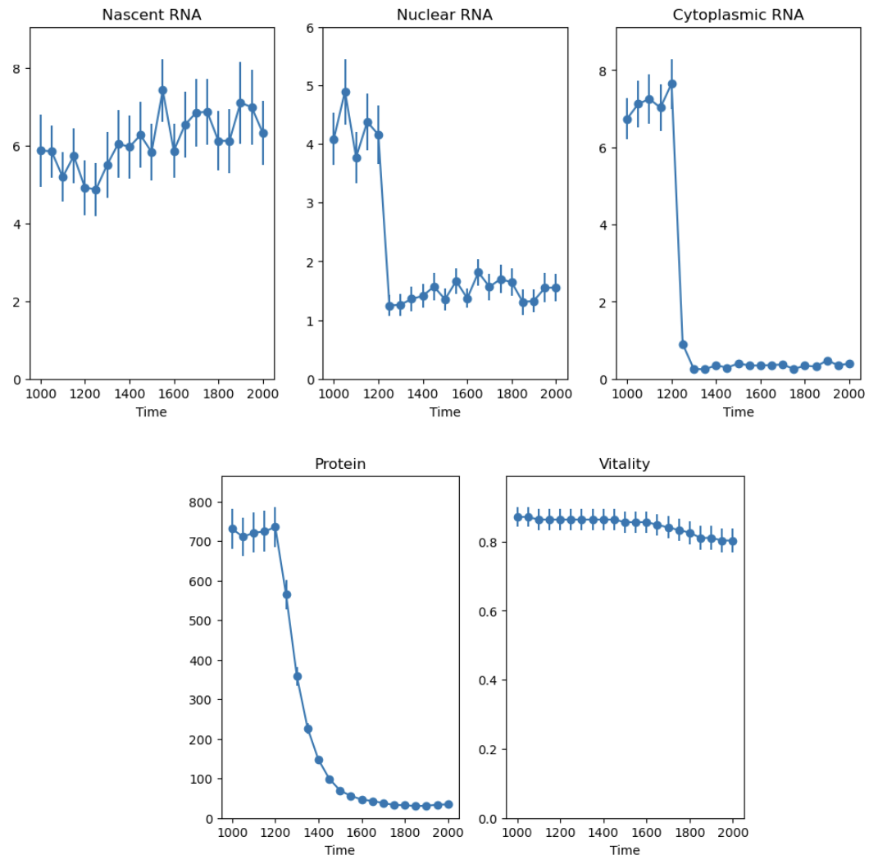
Drug 7

Slide 18
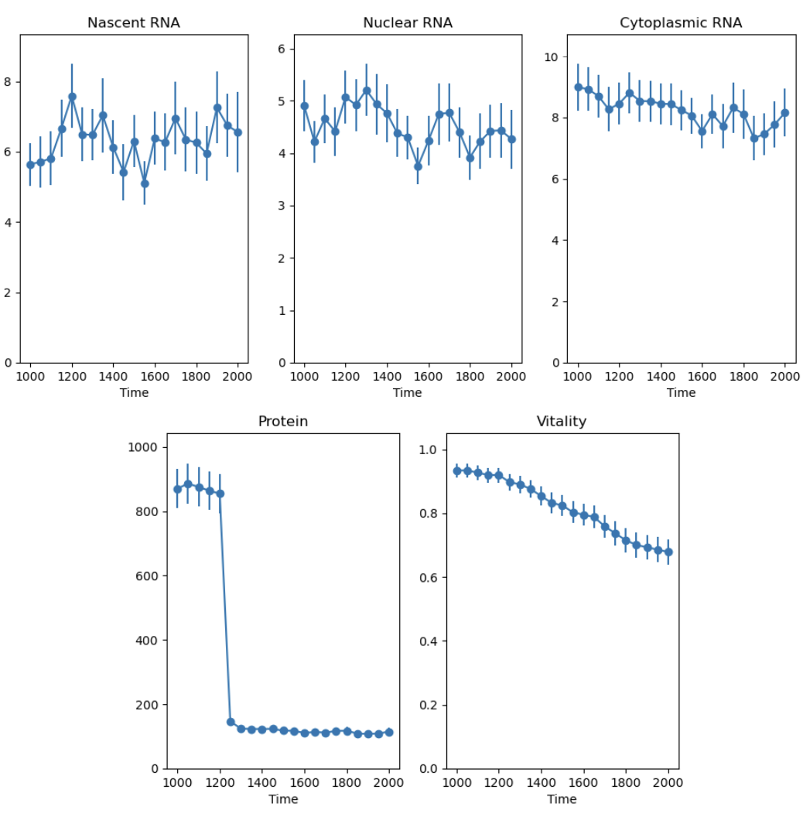
Drug 10

Slide 19
Stages 3 and 4: Model Generation, Parameterization, and Design

Slide 20
Pre-Selection of Drugs Concentrations
DRUG | 100nM | 300nM | 1000nM | 3000nM | 10000nM
Drug2 | OK | OK | OK | ----------------- | -----------------
Drug4 | OK | OK | OK | ----------------- | -----------------
Drug6 | OK | OK | OK | ----------------- | -----------------
Drug7 | OK | OK | OK | OK | -----------------
Drug10 | OK | OK | OK | ----------------- | -----------------
__ PROTEIN NOT AFFECTED | OK: vitality > 20% | t = 1200

Slide 21
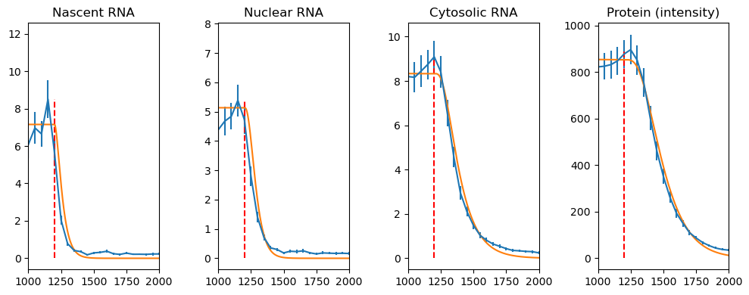
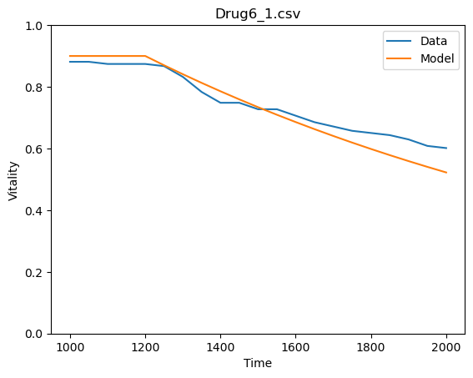
Model Plots
Example: Drug 6 – 1000 nM

Slide 22
Drug | Concentration (nM) | J
10 | 100 | 1.0062
10 | 300 | 0.8624
10 | 1000 | 0.8152
10 | 3000 | 0.3002
10 | 10000 | 0.0917
2 | 100 | 0.8520
2 | 300 | 0.7951
2 | 1000 | 0.7951
2 | 3000 | 0.3021
2 | 10000 | 0.0931
4 | 100 | 0.8705
4 | 300 | 0.7554
4 | 1000 | 0.8022
4 | 3000 | 0.2913
4 | 10000 | 0.0909
6 | 100 | 1.0172
6 | 300 | 1.0479
6 | 1000 | 0.8268
6 | 3000 | 0.3099
6 | 10000 | 0.0909
7 | 100 | 0.8741
7 | 300 | 0.7819
7 | 1000 | 0.9390
7 | 3000 | 0.3867
7 | 10000 | 0.0994

Slide 23

Final Decision
Drug 6 showed the maximum J value for a little concentration.
Drug 10 and 7, showed a better effect for the protein concentration and vitality, but we need a higher concentration.
Drug 7 showed a better vitality but Drug 10 present a faster decrease of protein concentration.
Drug
6
Drug
7
Drug
10
Drug
6

Slide 24
Thank you!

